Slide 1

Business Analytics
Chapter - 1
Business Analytics
Basic Data Exploration with Statistics

Slide 2
Introduction
Importance of Analytics.
Attrition
Car Pooling
Credit Approval
Marketing
Presidential Campaigns
Backbone of Analytics
Mathematics
Stats

Slide 3
Data/Attribute Types
Attribute (or dimensions, features, variables): a data field, representing a characteristic or feature of a data object.
E.g., customer _ID, name, address
Types:
Nominal = Categorical
Binary
Ordinal
Numeric: quantitative
Interval-scaled
Ratio-scaled

Slide 4
Attribute Types
Nominal: categories, states, or “names of things”
Hair_color = {auburn, black, blond, brown, grey, red, white}
marital status, occupation, ID numbers, zip codes
Binary
Nominal attribute with only 2 states (0 and 1)
Symmetric binary: both outcomes equally important
e.g., gender
Asymmetric binary: outcomes not equally important.
e.g., medical test (positive vs. negative)
Convention: assign 1 to the important outcome (e.g., HIV positive)

Slide 5
Attribute Types
Ordinal
Values have a meaningful order (ranking) but magnitude between successive values is not known.
Size = {small, medium, large}, grades, army rankings

Slide 6
Interval :- Has values of equal interval
Examples:
Celsius Temperature.
Fahrenheit Temperature.
IQ (intelligence scale).
SAT scores.
Time on a clock with hands.
Ratio: exactly the same as the interval scale except that the zero on the scale means: does not exist. For example, a weight of zero doesn’t exist; an age of zero doesn’t exist. On the other hand, temperature is not a ratio scale, because zero exists (i.e. zero on the Celsius scale is just the freezing point; it doesn’t mean that water ceases to exist).
Example
Weight.
Height.
Sales Figures.
Ruler measurements.
Income earned in a week.
Years of education.
Number of children.

Slide 7
Numeric Attribute Types
Quantity (integer or real-valued)
Interval :- a scale of measurement of data according to which the differences between values can be quantified in absolute but not relative terms and for which any zero is merely arbitrary: for instance, dates are measured on an interval scale since differences can be measured in years, but no sense can be given to a ratio of times
Measured on a scale of equal-sized units
Values have order
» E.g., temperature in C˚or F˚, calendar dates
No true zero-point
Rare Attribute Type
Ratio
•
•
Inherent zero-point
We can speak of values as being an order of magnitude larger
than the unit of measurement (10 K˚ is twice as high as 5 K˚).
– e.g., temperature in Kelvin, length, counts, monetary quantities

Slide 8
Discrete vs. Continuous Attributes
Discrete Attribute
Has only a finite or countably infinite set of values
E.g., zip codes, profession, or the set of words in a collection of
documents
Sometimes, represented as integer variables
Note: Binary attributes are a special case of discrete attributes
Continuous Attribute
Has real numbers as attribute values
E.g., temperature, height, or weight
Practically, real values can only be measured and represented using a finite number of digits
Continuous attributes are typically represented as floating-point
variables

Slide 9
Analysis of Attribute Types
Scale | Definition | Examples
Nominal | Categorizes but does not rank | Industries, Gender, Occupation
Ordinal | Ranked Categories. Differences between ranks not consistent | Organizational Hierarchy. Star Ratings
Interval | Ranks Data. Differences between ranks equal. No True Zero Point. | Celsius or Fahrenheit Scale. Dates
Ratio | Ranks Data. Differences between ranks equal. Also has a True Zero Point. | Rate of Return, Money

Slide 10
Frequency Distribution
Frequency distribution is a representation, either in a graphical or tabular format, that displays the number of observations within a given interval.
In Frequency distribution, we find the number of counts for a particular observation when the observations are repeated.
For example:
The height of children can be split into several different categories or ranges. When measuring the height of 100 children, some are tall and some are short, but there is a high probability of a higher frequency or concentration in the middle range. The most important factors are that the intervals used must be non-overlapping and must contain all of the possible observations.

Slide 11

Frequency Distribution in Excel
Steps:
Enter the data in column and sort it in ascending order by Data
Note the minimum & maximum values and prepare the bins of
Sort
appropriate sizes e.g , suppose the data ranges from 0 to 100 then the
bins will be ( 1-10,11-21,…,91-100).
Now create a table with column headers ‘Bins’ and ‘Frequency’ and
type in the bin ranges.
Use the countif function to fill in the frequency column for each of the bin.
For the first bin:
countif([select data], “[< starting value of second bin]”)
For rest of the bins:
countif([select data], “[< starting value of next highest bin]”) –
countif([select data], “[< starting value of selected bin]”)

Slide 12
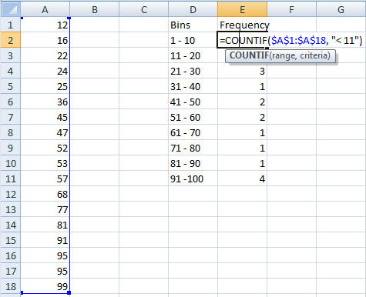
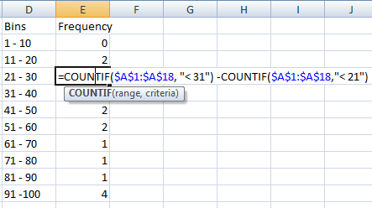
Frequency Distribution in Excel

Slide 13


Frequency Distribution in R
Consider the inbuilt R dataset faithful.
We will find the frequency distribution for the variable ‘eruptions’.
Now we break the range into non-overlapping sub-intervals by defining a sequence of equal distance break points. If we round the endpoints of the interval [1.6, 5.1] to the closest half-integers, we come up with the interval [1.5, 5.5]. Hence we set the break points to be the half-integer sequence { 1.5, 2.0, 2.5, ... }.

Slide 14
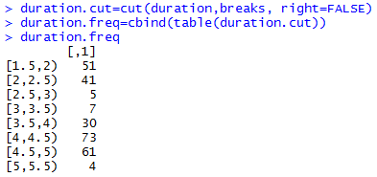
Frequency Distribution in R
Classify the eruption durations according to the half-unit-length sub- intervals with cut. As the intervals are to be closed on the left, and open on the right, we set the right argument as FALSE.

Slide 15
Histogram
Histogram is a graph used for the representation of the frequency
distribution.
It is series of adjacent rectangles erected on X-axis with class
interval as base and Frequency on the Y-axis.
Histograms are useful to find mode and understand the spread of the distribution (which will be discussed later).
Example:
Consider the following data to plot the histogram
Monthly House Rent | 100 - 300 | 300 - 500 | 500 - 700 | 700 - 900 | 900 - 1100 | 1100 - 1300
No. of families | 6 | 16 | 24 | 20 | 10 | 4

Slide 16
Histogram in Excel
Select the Frequency column and go to
Insert Charts Column 2D Clustered Column
To get the correct bin labels on the horizontal axis, right click anywhere on the chart and go to Select Data. Click on the small box to the
right of the “Category (X) axis labels.” Highlight the bin labels in the frequency distribution table and hit Return and click Ok.
Double click on one of the bars in the chart, which will open the “Format Data Series” box. Under Options, change the “Gap width” to be 0% and click Ok.
Give appropriate title name and axes names.

Slide 17
Histogram in Excel
Histogram
30
25
20
15
10
5
0
100 - 300
300 - 500
500 - 700
700 - 900
900 - 1100
1100 - 1300

Slide 18
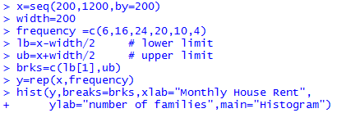
Histogram in R
Consider the same data used for histogram in excel.
Find the midpoints ( (lower limit + upper limit)/2) for all the intervals.
e.g. if the interval is 100 – 300 then 100 is lower limit and 300 is upper limit.
These mid points will form x in our example.

Slide 19
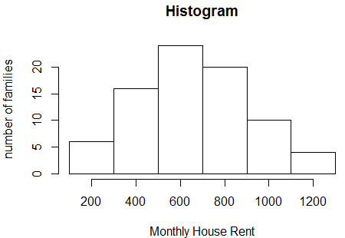
Histogram in R

Slide 20
Frequency Polygon
Frequency polygon is an another way of representing the frequency
distribution graphically.
It enables us to understand the pattern in the data more clearly.
Mid-values are taken on X-axis and frequencies are taken on Y-axis and the successive points are joined by the line segments.
To complete the polygon we obtain closed figure by taking two more classes, one preceding to first class and the other succeeding to last class. Frequency of these classes is taken to be zero.

Slide 21
Frequency Polygon in Excel
Consider the same data used for histogram.
Find the mid-points by taking two more classes and their frequencies
as zero.
Select mid-points and frequency columns and go to
Insert Chart Scatter with straight lines and markers
Give appropriate title name and axes names.

Slide 22
Frequency Polygon in Excel
Frequency Polygon
30
25
20
15
10
5
0
No. of families
0
200
400
600 800 1000
Midpoints (Monthly Rent)
1200
1400
1600

Slide 23

Frequency Polygon in R
Consider the same data used for histogram.

Slide 24
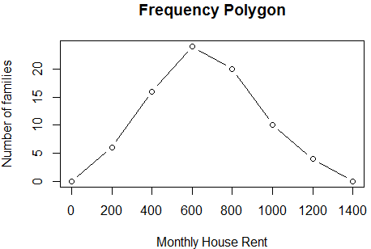
Frequency Polygon in R

Slide 25

Business Analytics
Business Analytics
Measures of Central Tendency &
Dispersion

Slide 26
Introduction to Central Tendency and Dispersion
Lets say you are the captain of the Indian Cricket Team. We have already batted and the Australians are batting now. They require 10 runs from the last over to win. You have two good bowlers that still have an over to bowl. Who should you send to bowl the last over?
Without any extra data each is as good as the other.
Suppose you now know that Bowler A concedes 8 runs on an average, Bowler B concedes 6 runs on an average. Now who should we send in to bowl?

Slide 27
Introduction to Central Tendency and Dispersion
Will a lower average always be better in such cases. Lets add some more data to what we already know. Bowler A concedes 8 runs on an average with a standard deviation of 0 runs which means he always concedes exactly 8 runs, neither more nor less ( a little unrealistic).
Bowler B concedes 6 runs on an average with a standard deviation of 4 runs that means he is quite erratic and may concede anything between zero to a large number. Now who will you choose?
With a consistent eight runs you know that you have a 100% chance of winning.

Slide 28
Mode
The frequency of an attribute value is the percentage of time the value
occurs in the data set. (We have already seen this)
For example, given the attribute 'gender' and a representative population of people, the gender 'female' occurs about 50% of the time.
The mode of an attribute is the most frequent attribute value
The notions of frequency and mode are typically used with categorical
data but it can be used on any data type.

Slide 29
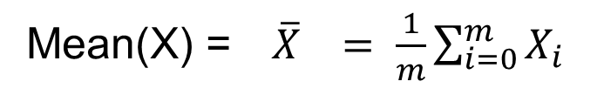
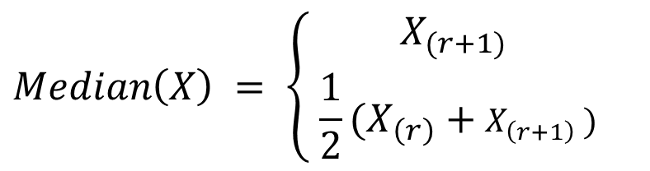
Mean and Median
The mean is the most common measure of the location of a set of
points
However, the mean is very sensitive to outliers
Thus, the median or a trimmed mean is also commonly used. Trimmed
here means outliers are removed.
Mean can only be used with numeric whereas median works with both ordinal and numeric.
If m is odd, i.e., m = 2r + 1 If m is even, i.e., m = 2r

Slide 30
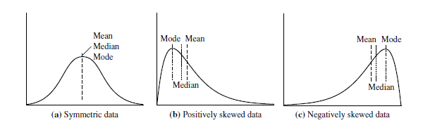
Skewness and Central Tendency

Slide 31
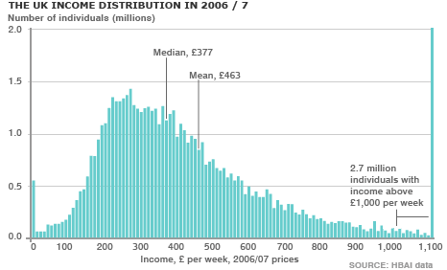
Mean and Median – Resistant Measure?

Slide 32
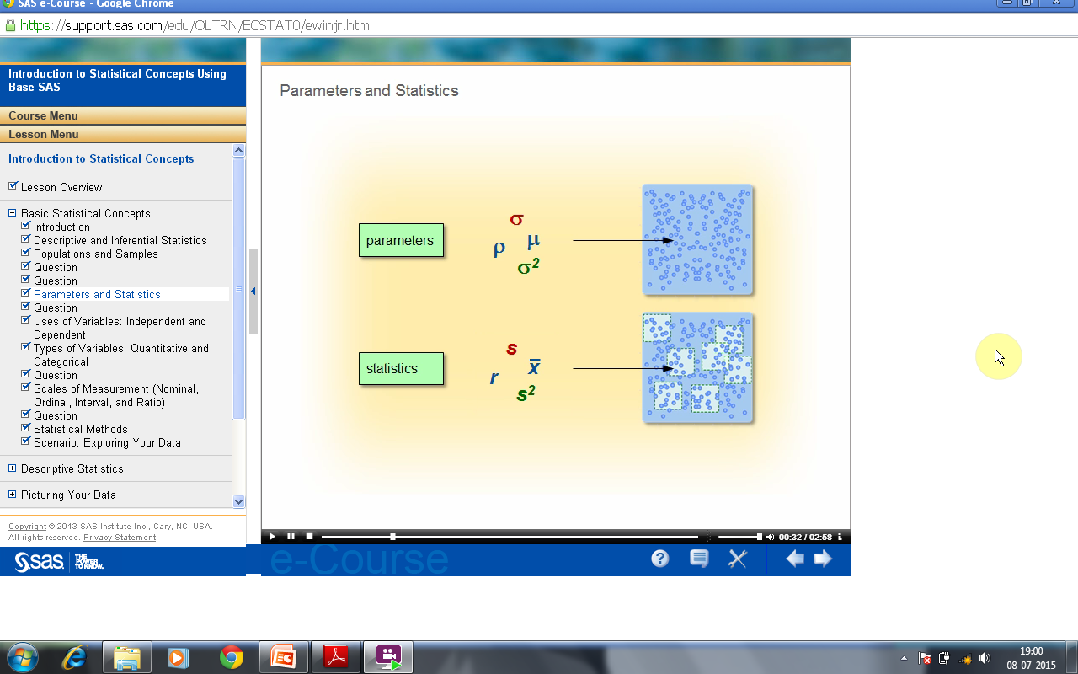
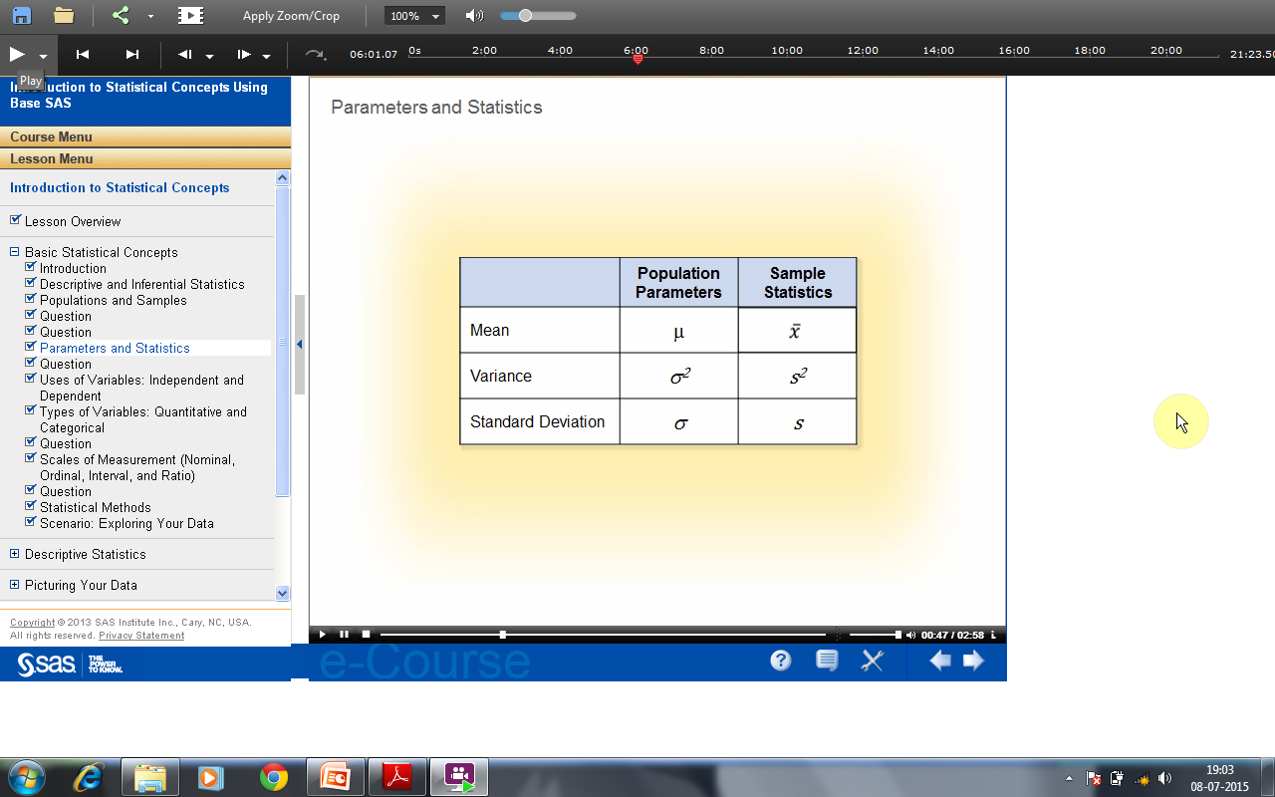
Parameters
Parameters are numerical values that summarize characteristics of a population. Parameter values are typically unknown and are represented by Greek letters. Statistics summarize characteristics of a sample. We use letters from the English alphabet to represent sample statistics. We can measure characteristics of your sample and provide numerical values that summarize those characteristics. We use statistics to estimate parameters.

Slide 33
Measuring Dispersion
Start with explaining the meaning of dispersion, you can refer again to
the bowling example. Continue with percentiles and the following:
Quartiles, outliers and boxplots
Quartiles: Q₁ (25th percentile), Q₃ (75th percentile)
Inter-quartile range: IQR = Q₃ – Q₁
Five number summary: min, Q₁, median, Q₃, max
Boxplot: ends of the box are the quartiles; median is marked; add whiskers, and plot outliers individually
Outlier: usually, a value higher/lower than 1.5 x IQR

Slide 34
Measuring Dispersion
Variance and standard deviation (sample: s, population: σ)
Variance: (algebraic, scalable computation)
Standard deviation s (or σ) is the square root of variance s² ⁽or σ²⁾
1
n
s = _{n −} ∑(x_{i} − x)
1
n
2
2
σ = ∑(x − μ)
2 2
1 i=1
N
i
i=1

Slide 35
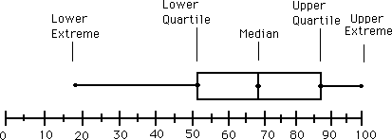
Boxplots
Five-number summary of a distribution
– Minimum, Q1, Median, Q3, Maximum
Boxplot
Data is represented with a box
The ends of the box are at the first and third quartiles, i.e., the
height of the box is IQR
The median is marked by a line within the box

Slide 36
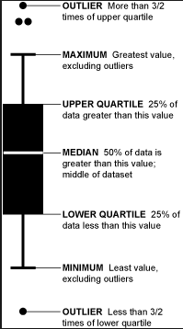
Boxplots
Whiskers:
Two lines outside the box extended to Minimum and Maximum
Outliers:
Points beyond a specified outlier threshold, plotted individually

Slide 37
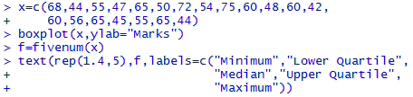
Boxplot in R
Example:
Marks obtained (out of 100) by 20 students are in a class test are as
given below:
68, 44, 55, 47, 65, 50, 72, 54, 75, 60, 48, 60, 42, 60, 56, 65, 45, 55, 65,
44.
Draw a boxplot.

Slide 38
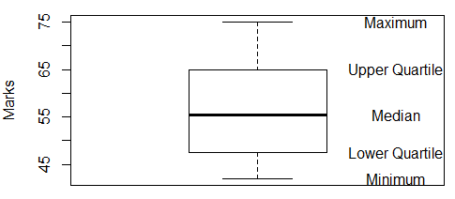
Boxplot in R

Slide 39
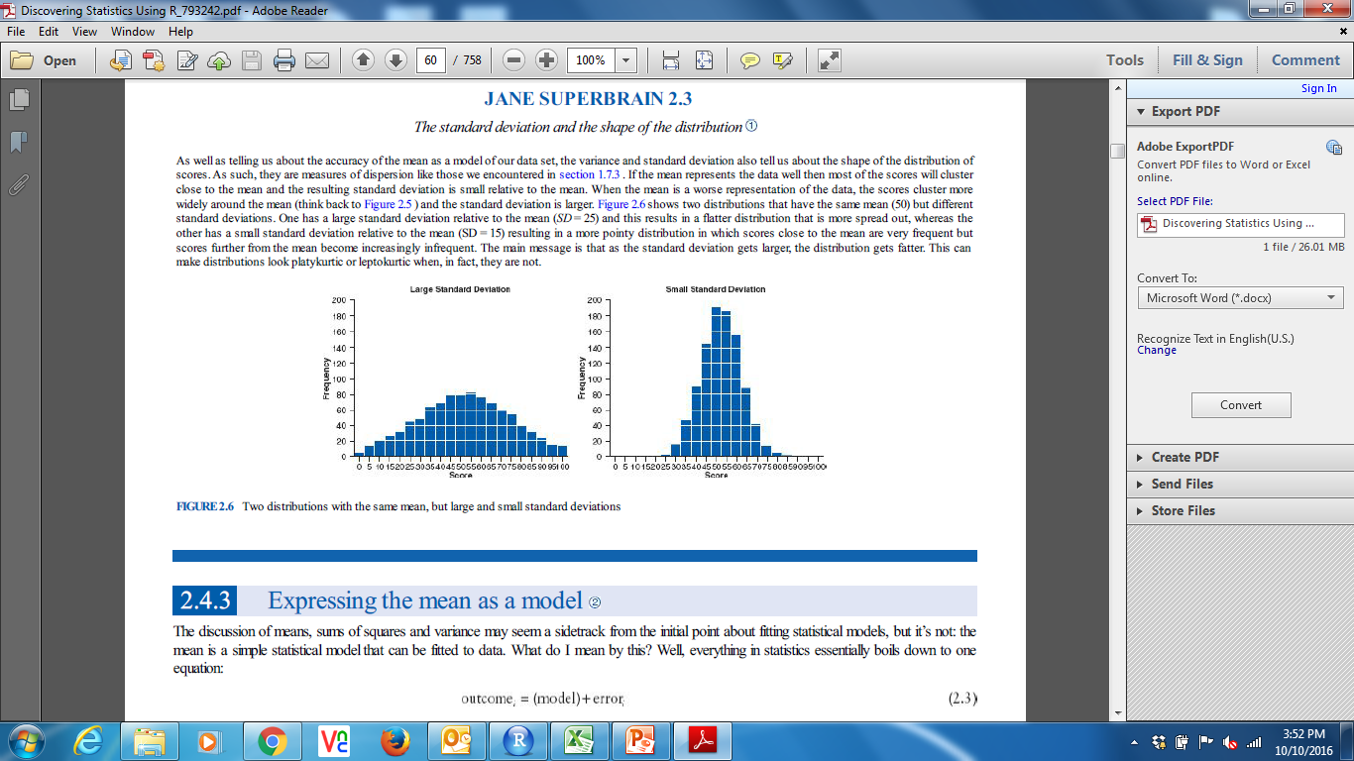
Standard Deviation
Standard Deviation
The Standard Deviation is a measure of how spread out numbers
are.
Symbol : σ (the greek letter sigma)
The formula is easy: it is the square root of the Variance. So now
you ask, "What is the Variance?"

Slide 40
SD & Variance
Variance:
The Variance is defined as:
The average of the squared differences from the Mean.
To calculate the variance follow these steps:
Work out the Mean (the simple average of the numbers)
Then for each number: subtract the Mean and square the result
(the squared difference).
Then work out the average of those squared differences.

Slide 41
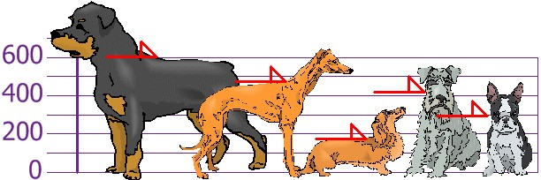
Example
You and your friends have just measured the heights of your dogs
(in millimeters):
The heights (at the shoulders) are: 600mm, 470mm, 170mm, 430mm and 300mm.
Find out the Mean, the Variance, and the Standard Deviation.

Slide 42
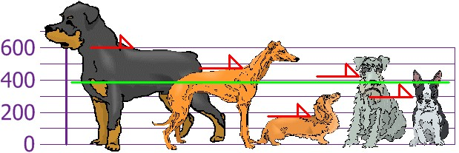
SD & Variance
Your first step is to find the Mean:
Answer:
600 + 470 + 170 + 430 + 300
=
1970
Mean =
= 394
5 5
so the mean (average) height is 394 mm. Let's plot this on the
chart:

Slide 43
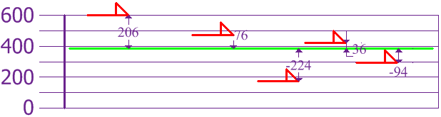
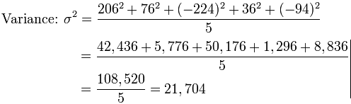
SD & Variance
Now we calculate each dog's difference from the Mean:
To calculate the Variance, take each difference, square it, and then average the result:

Slide 44
SD & Variance
So, the Variance is 21,704.
And the Standard Deviation is just the square root of Variance, so:
Standard Deviation: σ = √21,704 = 147.32... = 147 (to the nearest
mm)
And the good thing about the Standard Deviation is that it is useful. Now we can show which heights are within one Standard Deviation (147mm) of the Mean:

Slide 45
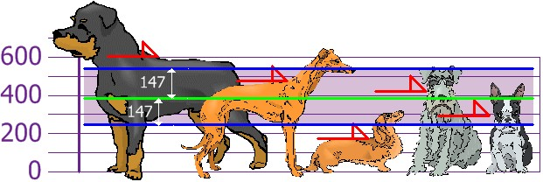
SD & Variance
So, using the Standard Deviation we have a "standard" way of knowing what is normal, and what is extra large or extra small.
Rottweilers are tall dogs. And Dachshunds are a bit short ... but
don't tell them!

Slide 46
SD & Variance
Our example was for a Population (the 5 dogs were the only dogs
we were interested in).
But if the data is a Sample (a selection taken from a bigger Population), then the calculation changes!
When you have "N" data values that are:
The Population: divide by N when calculating Variance (like we
did)
A Sample: divide by N-1 when calculating Variance

Slide 47
SD & Variance
All other calculations stay the same, including how we calculated
the mean.
Example: if our 5 dogs were just a sample of a bigger population of dogs, we would divide by 4 instead of 5 like this:
• Sample Variance = 108,520 / 4 = 27,130
Sample Standard Deviation = √27,130 = 164 (to the nearest mm)
Think of it as a "correction" when your data is only a sample.

Slide 48
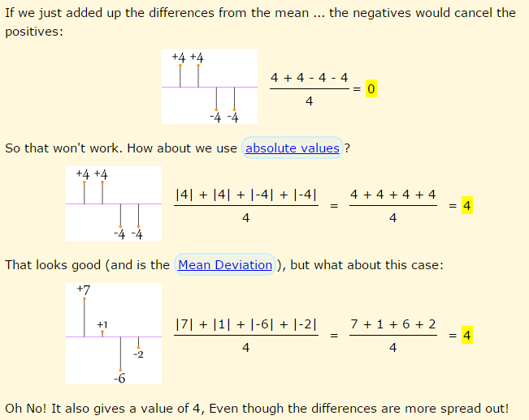

SD & Variance
Why Square the difference?

Slide 49
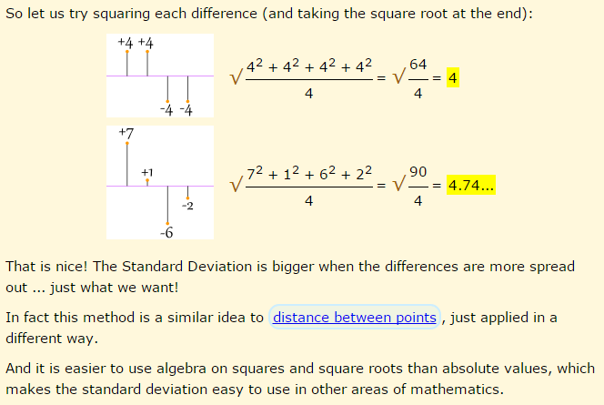
SD & Variance

Slide 50
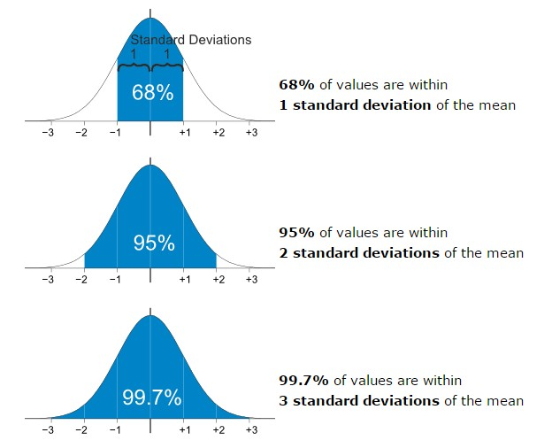
Standard Deviation
The Standard Deviation is a measure of how spread out numbers
are
When we calculate the standard deviation we find that (generally):

Slide 51
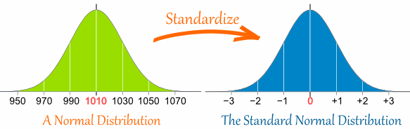
Standard Scores
The number of standard deviations from the mean is also called the "Standard Score", "sigma" or "z-score". Get used to those words!
So to convert a value to a Standard Score ("z-score"):
first subtract the mean,
then divide by the Standard Deviation
And doing that is called "Standardizing":
We can take any Normal Distribution and convert it to The
Standard Normal Distribution.

Slide 52
Example Travel Time
A survey of daily travel time had these results (in minutes):
26, 33, 65, 28, 34, 55, 25, 44, 50, 36, 26, 37, 43, 62, 35, 38, 45, 32,
28, 34
The Mean is 38.8 minutes, and the Standard Deviation is 11.4 ( N = 20) minutes (you can copy and paste the values into the Standard Deviation Calculator if you want).

Slide 53
Example Travel Time
Convert the values to z-scores ("standard scores").
To convert 26:
first subtract the mean: 26 - 38.8 = -12.8,
then divide by the Standard Deviation: -12.8/11.4 = -1.12
So 26 is -1.12 Standard Deviations from the Mean

Slide 54
Standard Scores
Here are the first three conversions
Original Value | Calculation | Standard Score (z-score)
26 | (26-38.8) / 11.4 = | -1.12
33 | (33-38.8) / 11.4 = | -0.51
65 | (65-38.8) / 11.4 = | +2.30
... | ... | ...

Slide 55
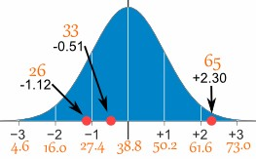
Standard Scores
And here they are graphically:
You can calculate the rest of the z-scores yourself!

Slide 56
Why Standardize?
It can help us make decisions about our data.
•
•
•
•
•
•
Example:-
Here are the students results (out of 60 points):
20, 15, 26, 32, 18, 28, 35, 14, 26, 22, 17
Most students didn't even get 30 out of 60, and most will fail. The test must have been really hard, so the Prof decides to
Standardize all the scores and only fail people 1 standard deviation
below the mean.

Slide 57
Why Standardize
The Mean is 23, and the Standard Deviation is 6.6, and the Standard Scores are:
-0.45, -1.21, 0.45, 1.36, -0.76, 0.76, 1.82, -1.36, 0.45, -0.15, -0.91
Only 2 students will fail (the ones who scored 15 and 14 on the test)

Slide 58
Business Analytics
Business Analytics
Normal Distribution

Slide 59
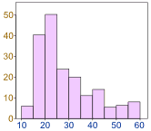
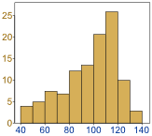
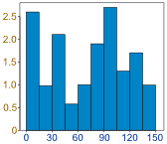
Normal Distribution
Data can be "distributed" (spread out) in different ways.
It can be spread out more on the left or to the right or it can
be all jumbled up as shown below.

Slide 60
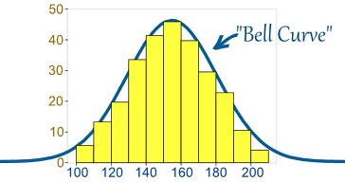
Normal Distribution
But there are many cases where the data tends to be around a central value with no bias left or right, and it gets close to a "Normal Distribution" like this:
A Normal Distribution
The "Bell Curve" is a Normal Distribution. And the yellow histogram shows some data that follows it closely, but not perfectly (which is usual).

Slide 61
Normal Distribution
Many things closely follow a Normal Distribution:
Heights of people
Size of things produced by machines
Errors in measurements
Blood pressure
Marks on a test

Slide 62
Normal Distribution
A normal distribution is a very important statistical data distribution pattern occurring in many natural phenomena, such as height, blood pressure, lengths of objects produced by machines, etc.
This is important to understand because if a distribution is normal, there are certain qualities that are consistent and help in quickly understanding the scores within the distribution

Slide 63
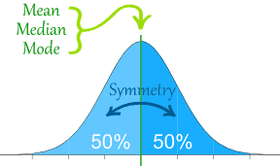
Normal Distribution
The Normal Distribution has:
mean = median = mode
symmetry about the center
50% of values less than the mean and 50% greater than the mean

Slide 64
Business Analytics
Business Analytics
Central Limit Theorem

Slide 65
Central Limit Theorem
In a world full of data that seldom follows nice theoretical
distributions, the Central Limit Theorem is a beacon of light.
Often referred to as the cornerstone of statistics, it is an important
concept to understand when performing any type of data analysis.
The Central Limit Theorem states that given a sufficiently large sample size from a population with finite mean and variance, the sampling distribution of mean approaches the normal distribution.
All this is saying is that as you take more samples, especially large ones, your graph of the sample means will look more like a normal distribution.

Slide 66
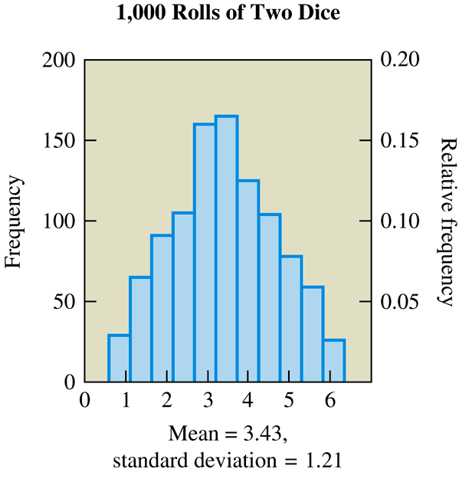
Visualizing the Central Limit Theorem Using Dice
Now suppose we roll two dice 1,000 times and record the mean of the two numbers that appear on each roll. To find the mean for a single roll, we add the two numbers and divide by 2.
64

Slide 67
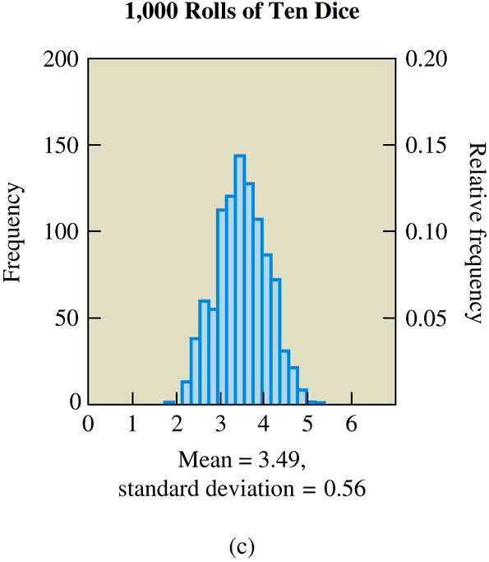
Visualizing the Central Limit Theorem Using Dice
Now we will further increase the number of dice to ten on each of
1,000 rolls.

Slide 68
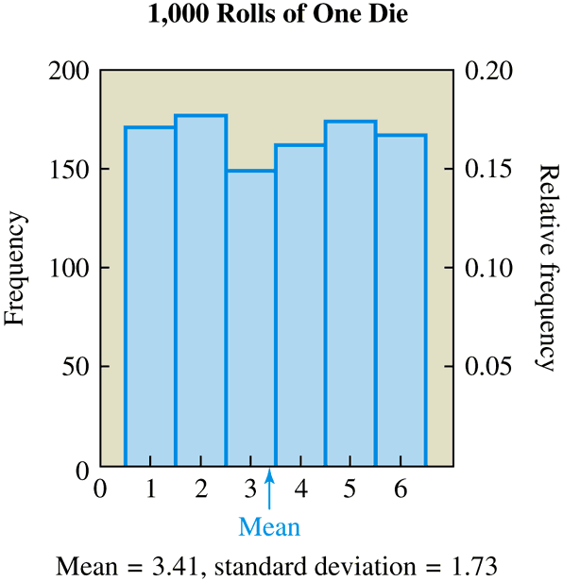
Visualizing the Central Limit Theorem Using Dice
Suppose we roll one die 1,000 times and record the outcome of
each roll, which can be the number 1, 2, 3, 4, 5, or 6.

Slide 69
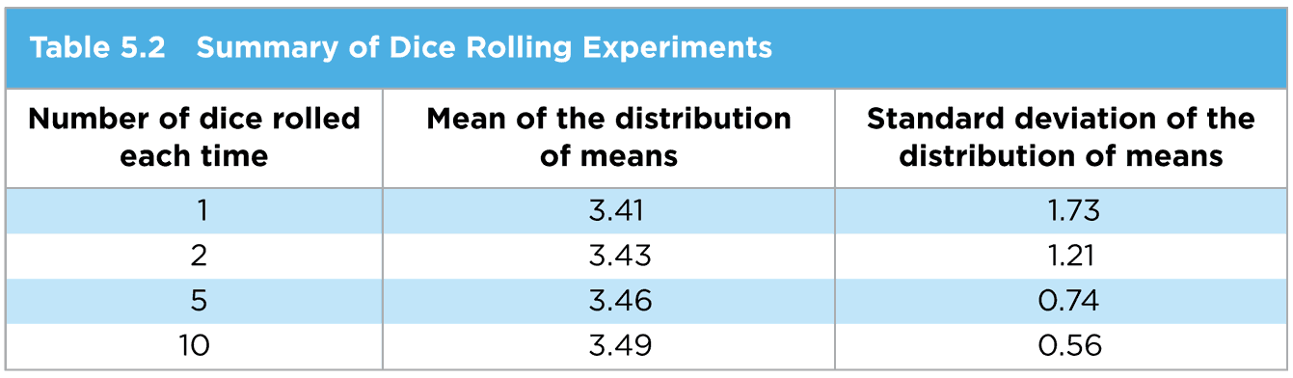
Visualizing the Central Limit Theorem Using Dice
What do you notice about the shape of the distribution as the sample size increases?
It approximates a normal distribution
What do you notice about the mean of the distribution of sample means as the sample size increases in comparison to the true mean of the population (3.5)?
It approaches the population mean

Slide 70
Visualizing the Central Limit Theorem Using Dice
What do you notice about the standard deviation of the distribution of
means as the sample size increases?
It gets smaller representing a lower variation

Slide 71
The Central Limit Theorem
The distribution of means will be approximately a normal
distribution for larger sample sizes
The mean of the distribution of means approaches the population mean, μ, for large sample sizes
The standard deviation of the distribution of means approaches to normal distribution for large sample sizes, where σ is the standard deviation of the population and n is the sample size

Slide 72
The Central Limit Theorem Notes
For practical purposes, the distribution of means will be nearly
normal if the sample size is larger than 30
If the original population is normally distributed, then the sample means will remain normally distributed for any sample size n, and it will become narrower
The original variable can have any distribution, it does not have to be a normal distribution

Slide 73
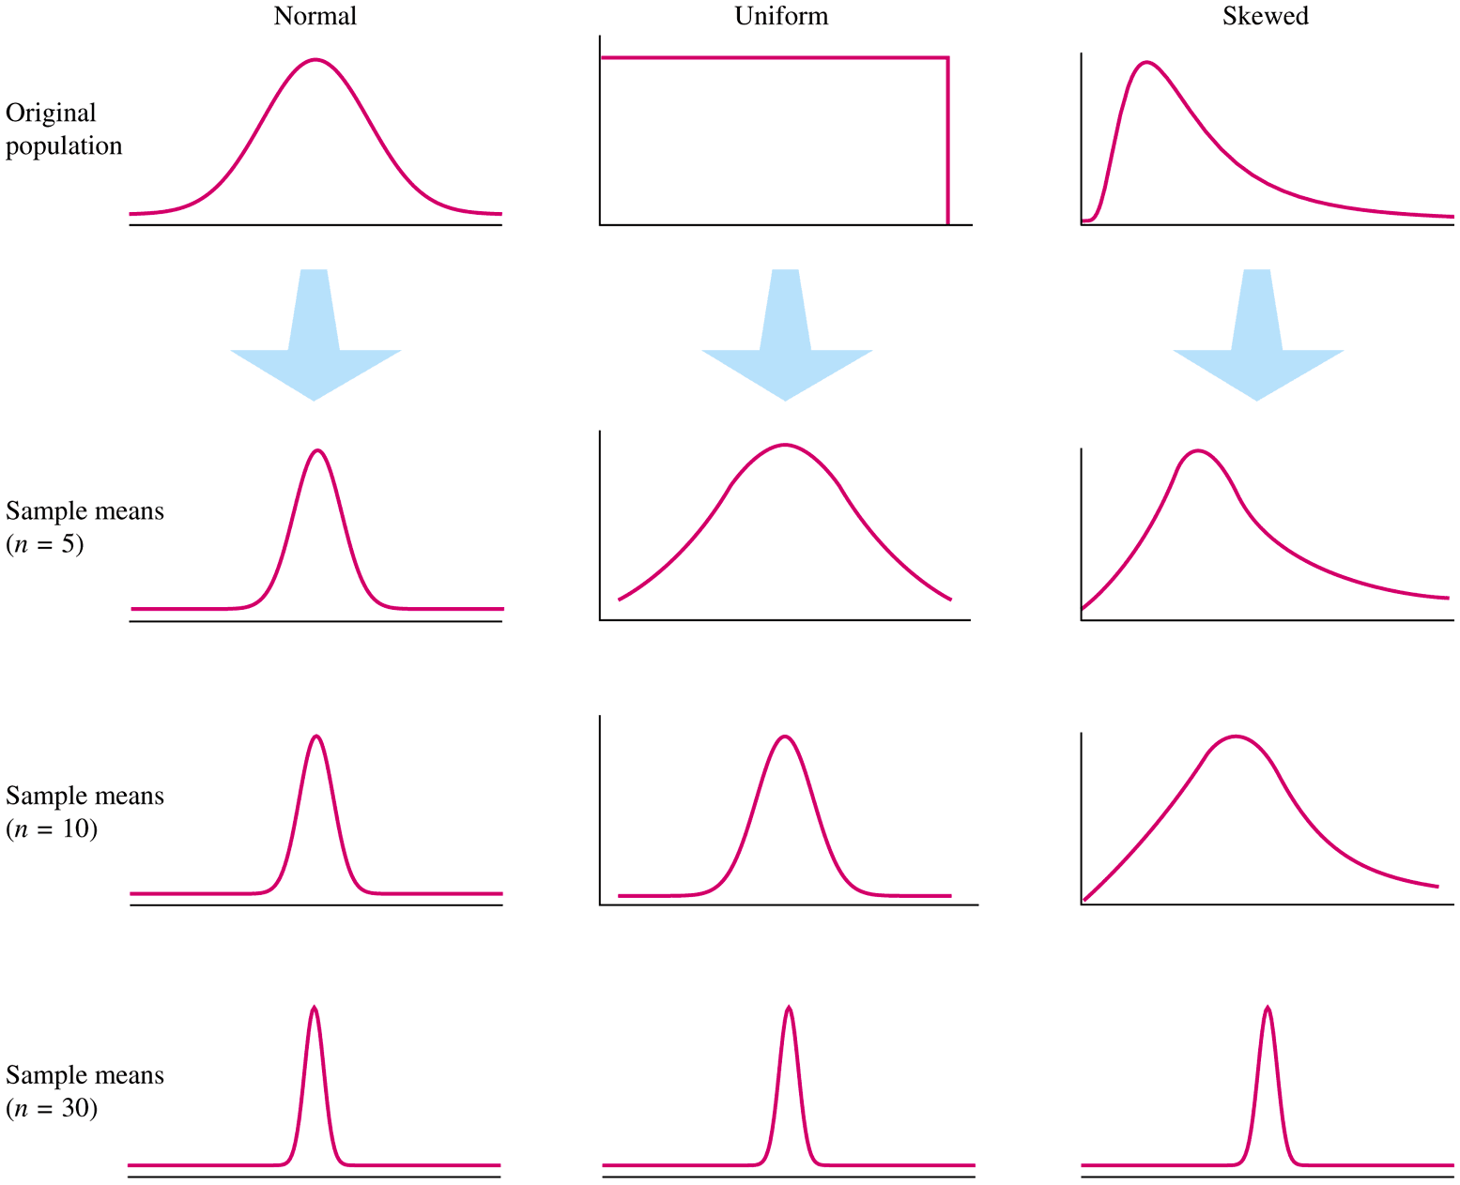
Shapes of Distributions as Sample Size Increases
http://onlinestatbook.com/stat_sim/sampling_dist/

Slide 74
The Normal Distribution
The most important continuous probability distribution is the Normal Distribution.
The reason is that it has a very important use in the statistical theory of drawing conclusions from sample data about the populations from which the samples are drawn, and in Statistical Process Control.
There are several characteristics that make the normal distribution very important for statisticians:
It is bell shaped
Symmetrical about Mean which is also Median and Mode
Most observations in the distribution are close to the mean, with gradually fewer observations further away

Slide 75
The Normal Distribution
It can be determined entirely by the values of µ and σ.
The spread of the distribution is measured by the standard distribution, may be large or small but in every case approximately
•68.3 % of all observations lie within µ+σ, (i.e 1 standard deviations of the mean) approximately two thirds observations
•95.4 % of all observations lie within µ+2σ
•99.7 % of all observations lie within µ+3σ

Slide 76
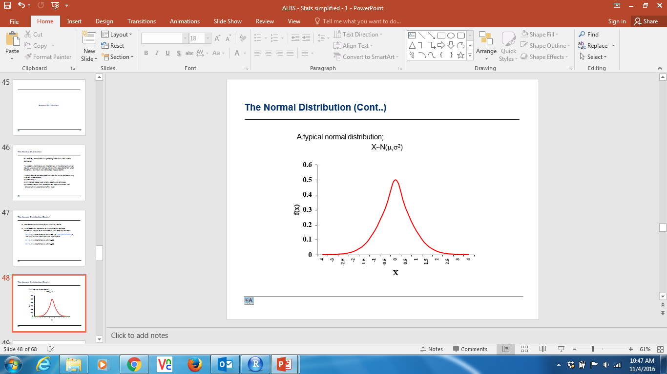
The Normal Distribution
A typical normal distribution;
X∼N(μ,σ²)

Slide 77
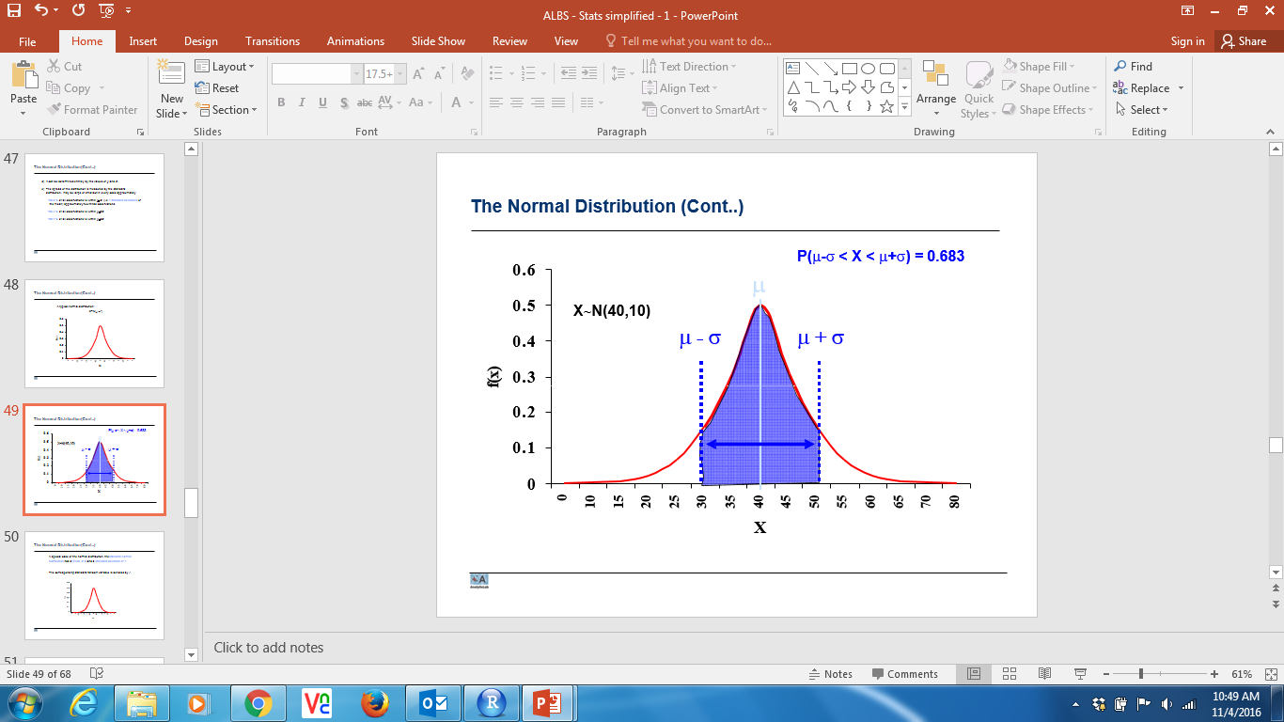
The Normal Distribution

Slide 78
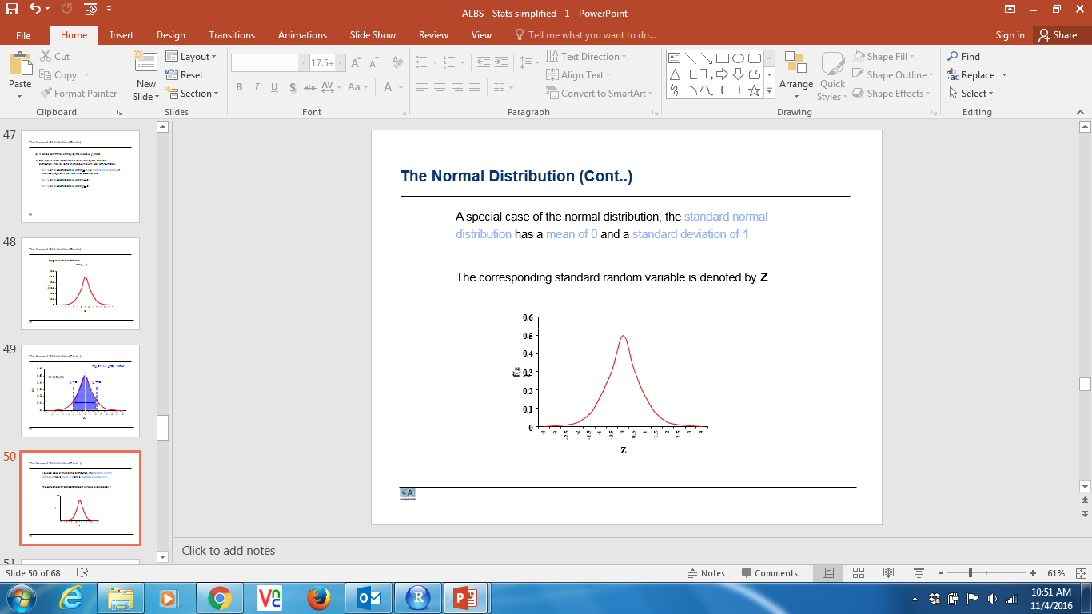
The Normal Distribution
A special case of the normal distribution, the standard normal distribution has a mean of 0 and a standard deviation of 1
The corresponding standard random variable is denoted by Z

Slide 79
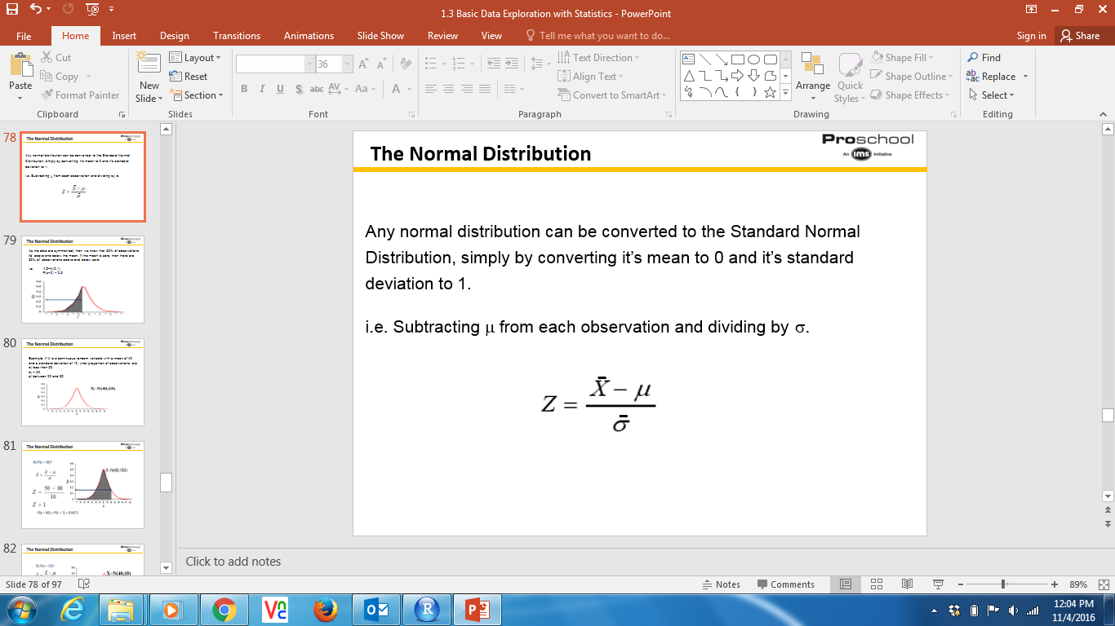
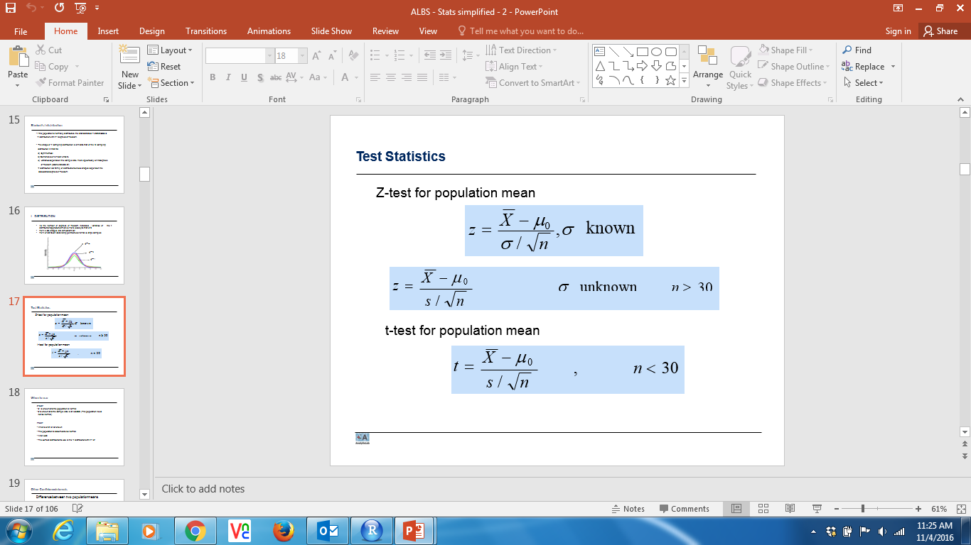
The Normal Distribution
Any normal distribution can be converted to the Standard Normal Distribution, simply by converting it’s mean to 0 and it’s standard deviation to 1.
i.e. Subtracting μ from each observation and dividing by σ.
= standard deviation of sampling distribution
= standard deviation of population/sqrt(sample size) . This term is written as

Slide 80
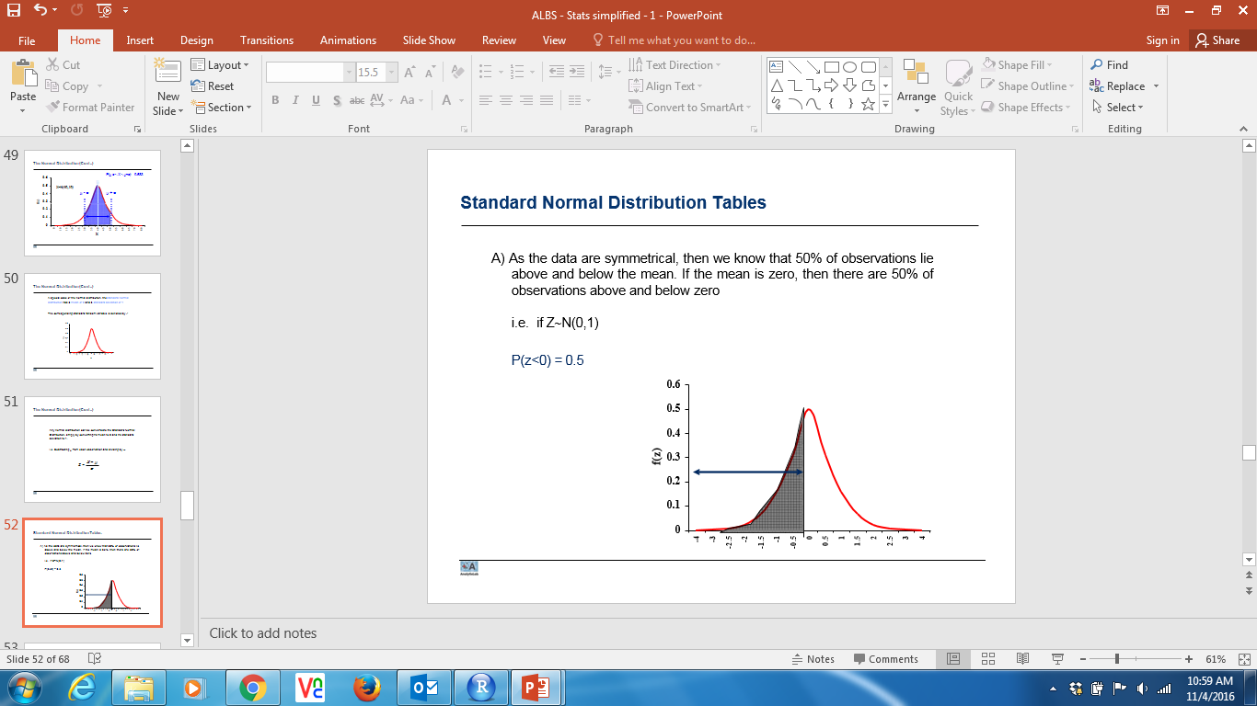
The Normal Distribution
As the data are symmetrical, then we know that 50% of observations lie above and below the mean. If the mean is zero, then there are 50% of observations above and below zero
i.e. if Z∼N(0,1)
P(z<0) = 0.5
Z

Slide 81
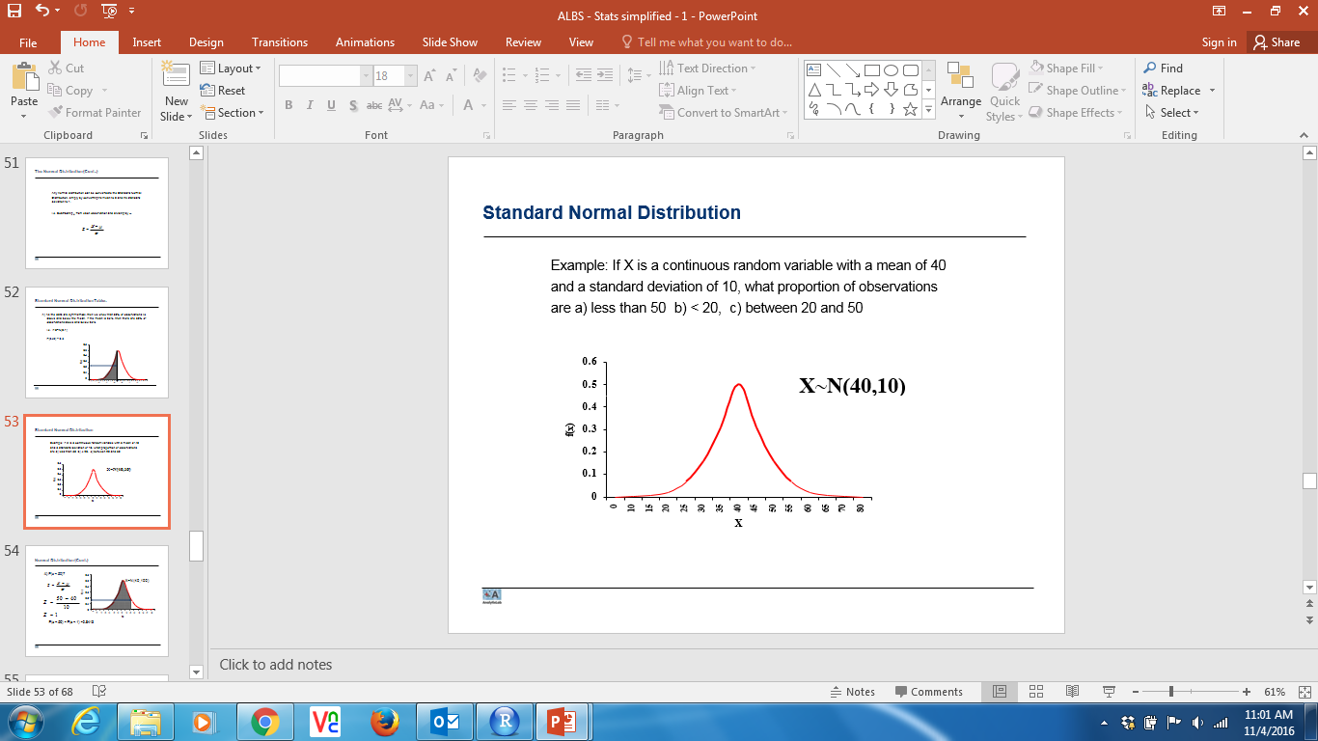
The Normal Distribution
Example: If X is a continuous random variable with a mean of 40 and a standard deviation of 10, what proportion of observations are a) less than 50
b) < 20,
c) between 20 and 50

Slide 82
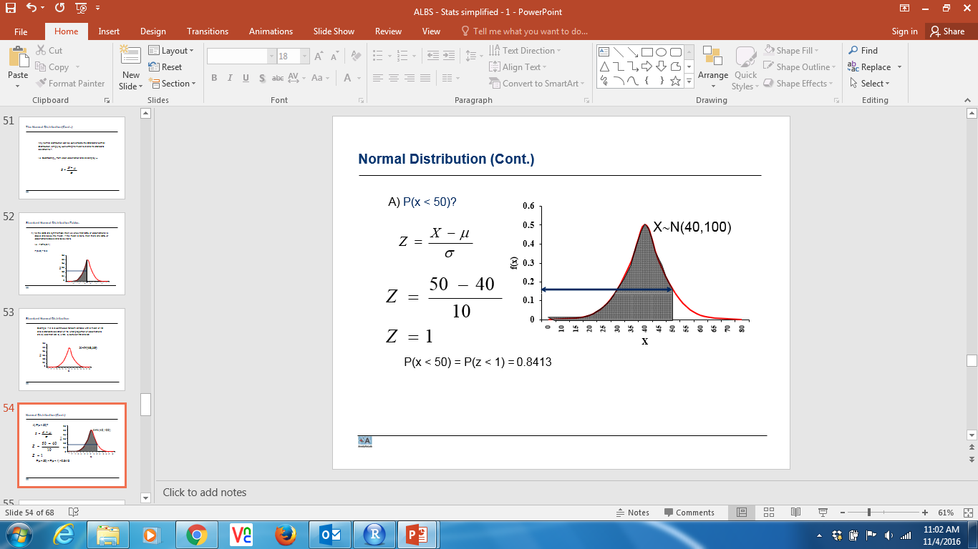
The Normal Distribution

Slide 83
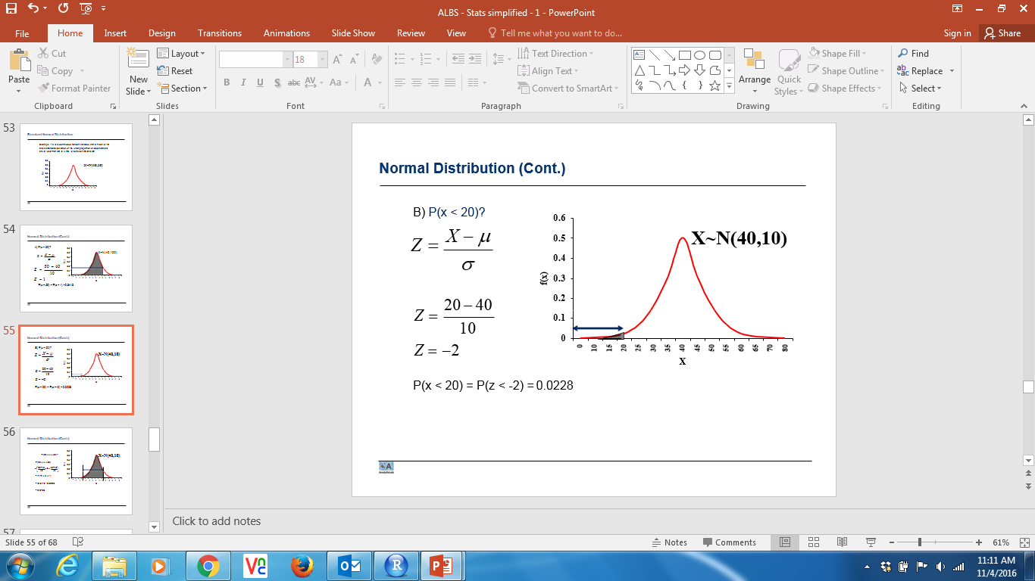
The Normal Distribution

Slide 84
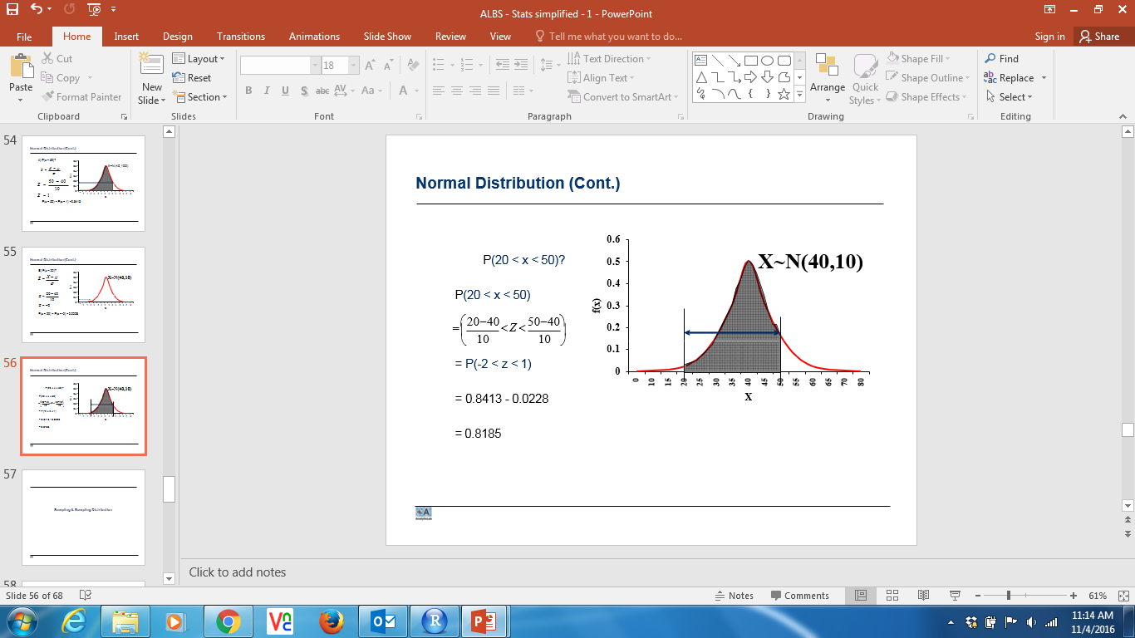
The Normal Distribution

Slide 85
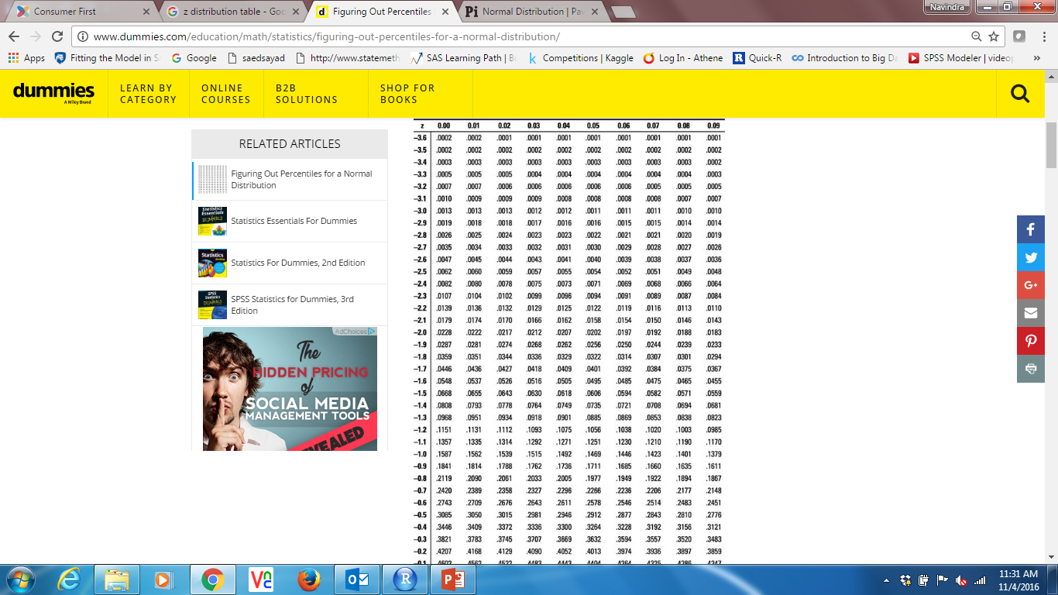
Example - Predicting Test Scores
You are a middle school principal and your 100 eighth-graders are about to take a national standardized test. The test is designed so that the mean score is μ = 400 with a standard deviation of σ = 70. Assume the scores are normally distributed.
What is the likelihood that one of your eighth-graders, selected at random, will score below 375 on the exam?
Since the distribution is normal, we can just use z-scores to determine the percentage for one student
z = ³⁷⁵ ⁻ ⁴⁰⁰ = −0.36
70

Slide 86
Example - Predicting Test Scores
According to the table, a z-score of -0.36 corresponds to about 36% which means that about 36% of all students can be expected to score below 375, thus there is a 36% chance that a randomly selected student will score below 375

Slide 87
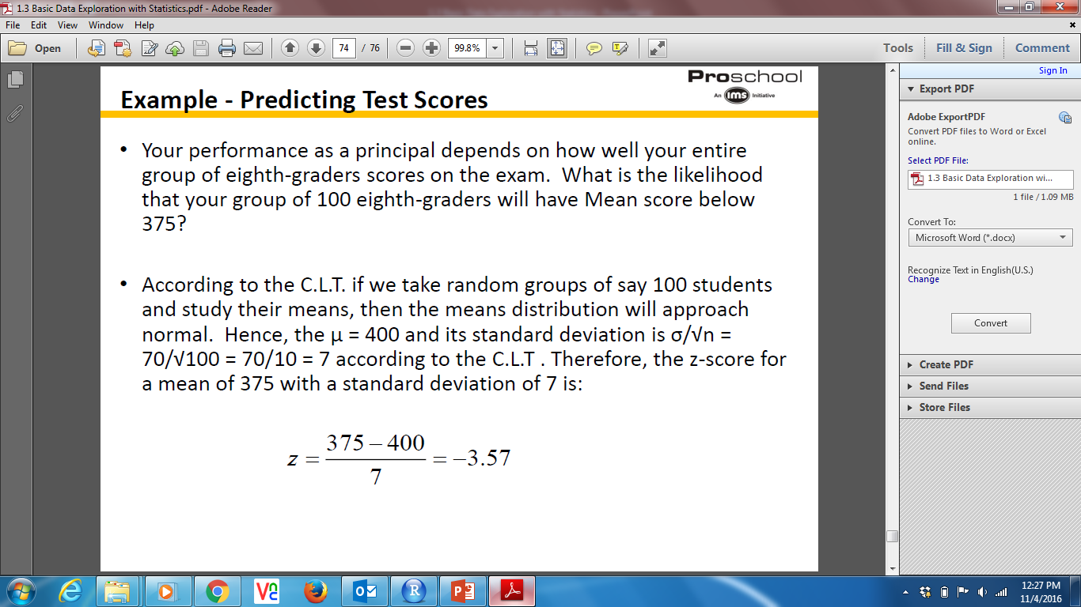
Example - Predicting Test Scores

Slide 88
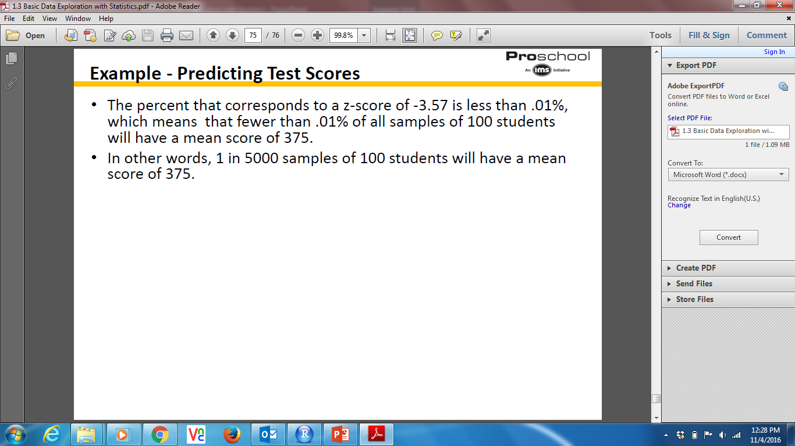
Example - Predicting Test Scores

Slide 89
Student’s t distribution
If the population is normally distributed, the standardized ‘t’ statistics has a ‘t’ distribution with n-1 degrees of freedom.
The shape of ‘t’ sampling distribution is similar to that of the ‘z’ sampling distribution in that it is
Symmetrical
Centered over a mean of zero
Variance depends on the sample size, more specifically on the degrees of freedom (abbreviated as df)
‘t’ distribution is a family of distributions whose shapes depend on the associated degrees of freedom

Slide 90

Student’s t distribution
As the number of degrees of freedom increases , variance of distribution approaches more & more closely to that of z
For n ≥ 30, shapes are almost similar
For n of 30 taken as dividing point between small & large samples

Slide 91
Student’s t distribution

Slide 92
When to use
z-test:
σ is known and the population is normal
σ is known and the sample size is at least 30. (The population need not be normal)
t-test:
Whenever σ is not known
The population is assumed to be normal
And n<30
The correct distribution to use is the ‘t’ distribution with n-1 df

Slide 93
Thank You…

